Slide 1

Vel Tech Rangarajan Dr. Sagunthala R&D Institute of Science and Technology
School of Computing
Department of Computer Science and Engineering
10211CS224 / FULL STACK APPLICATION DEVELOPMENT (JAVA)
PROJECT REVIEW : MILESTONE PROJECT – 1
Date: 24-03-2026
PROJECT TITLE
Automated quiz engine with pdf generation certification
Courses Handling Faculty:
Dr.S.Hemamalini

Slide 2
INTRODUCTION
The Hook: "In most organizations, 40% of administrative time in training is wasted on grading papers and manually typing out certificates. It’s a bottleneck that slows down growth."
The Problem: Manual systems are prone to human error, slow to scale, and provide zero real-time data on learner progress.
The Solution: "Today, we are introducing an automated ecosystem that turns raw content into a quiz, grades it instantly, and rewards the learner with a professional PDF certificate—all without a single human click.

Slide 3

PROBLEM STATEMENT
In digital learning, the "Moment of Achievement" is often lost.
Traditional systems decouple the assessment from the reward.
When a student finishes a quiz, the lack of instant gratification (immediate feedback and a tangible credential) leads to a 30% drop-off in course completion rates.
Current tools are either too expensive, too complex to integrate, or require manual intervention to issue credentials.

Slide 4
OBJECTIVE(S)
Zero-Touch Automation: Eliminate manual grading and certificate issuance by creating a fully autonomous pipeline from "Quiz Submission" to "Inbox Delivery."
Instant Feedback Loop: Provide learners with their scores and credentials within < 10 seconds of completion to maximize psychological "reward" and engagement.
Scalability & Performance: Design a system capable of processing 1,000+ simultaneous assessments without performance degradation or database locking.
Secure Credentialing: Issue tamper-proof PDF certificates with unique identifiers (QR codes or Serial IDs) to ensure authenticity and prevent forgery

Slide 5
PROPOSED SYSTEM
To make your system stand out, emphasize these two features:
Unique QR Verification: Every certificate includes a unique QR code. Anyone scanning it is taken to a verification URL, proving the certificate is authentic.
Anti-Plagiarism / Shuffling: The system doesn't just generate questions; it shuffles the order and options for every user to prevent cheating in high-stakes environments.

Slide 6
PROPOSED SYSTEM ARCHITECTURE
Input:
User registration, login credentials, subscription plan selection
Processing:
JavaScript tier logic, authentication validation, UI rendering
Database:
MySQL tables (Users & Subscriptions)
Output:
Dynamic dashboard displaying result details, certificate info

Slide 7
WORKFLOW
Ingest: AI Question Gen
.Attempt: Interactive Quiz \ Timer & Shuffling.
Grade: Instant Scoring \ Pass/Fail Logic.
Render: Dynamic PDF Generation\ QR Insertion.
Deliver: Email Dispatch \ Cloud Archiving

Slide 8
TECHNOLOGIES USED
Frontend:
HTML5, CSS, JavaScript
Backend:
Python with Flask
Database:
MySQL
Tools:
VS Code, XAMPP / Live Server, Browser DevTools
Hardware/Software Requirements:
Laptop with Internet, Modern Web Browser

Slide 9
MODULE DESCRIPTION
Module 1: User Authentication
Handles login validation and session persistence.
Module 2: Assessment & Logic Module
This module manages the user experience and the "Rules" of the quiz.
Module 3: Dynamic PDF Generation Module
The "Design" engine that produces the high-quality, personalized outcome.
Module 4: Analytics & Distribution Module
The "Management" layer for administrators and delivery.

Slide 10
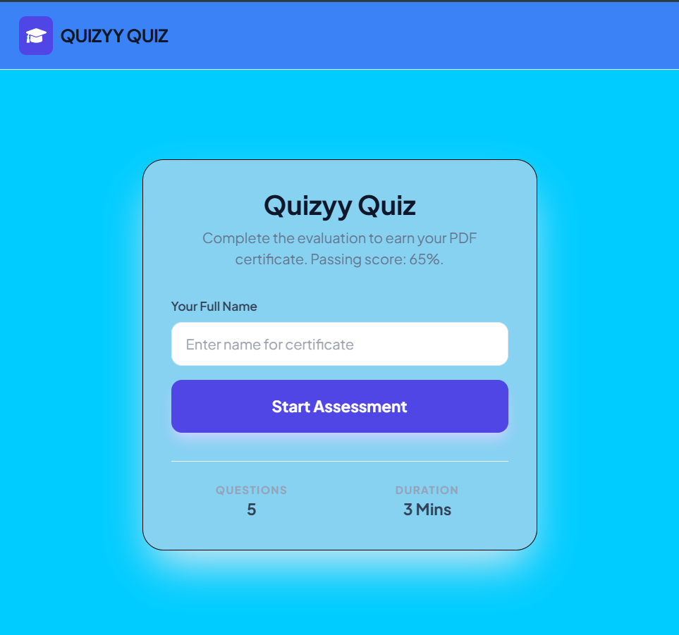
IMPLEMENTATION SCREENSHOTS
Allows users to enter credentials for authentication

Slide 11
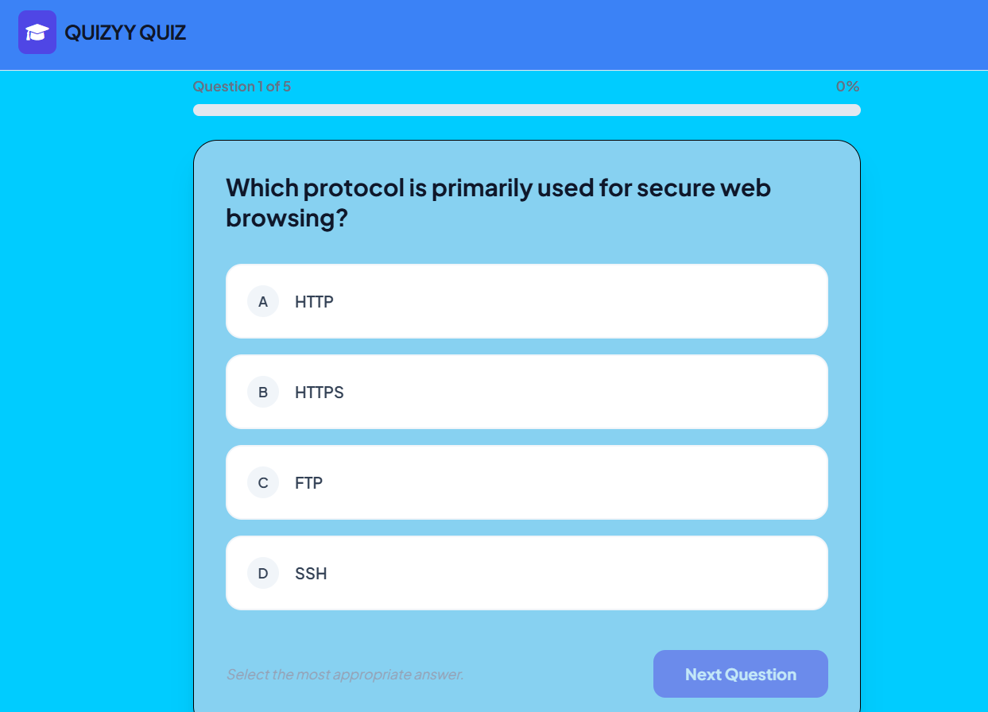
IMPLEMENTATION SCREENSHOTS
Displays picing plans and subscription options

Slide 12
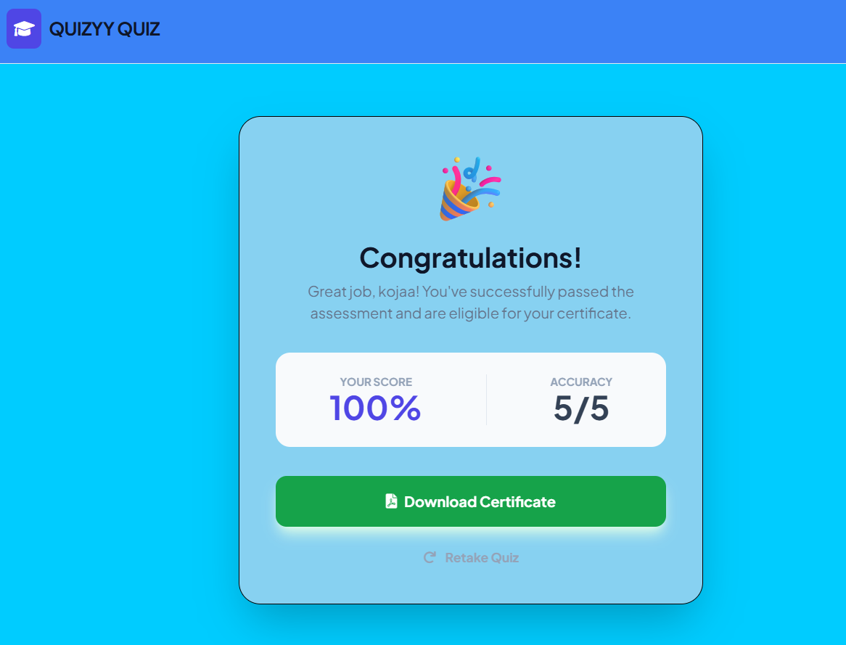
IMPLEMENTATION SCREENSHOTS
Shows active subsciption tier, blling details, and features

Slide 13
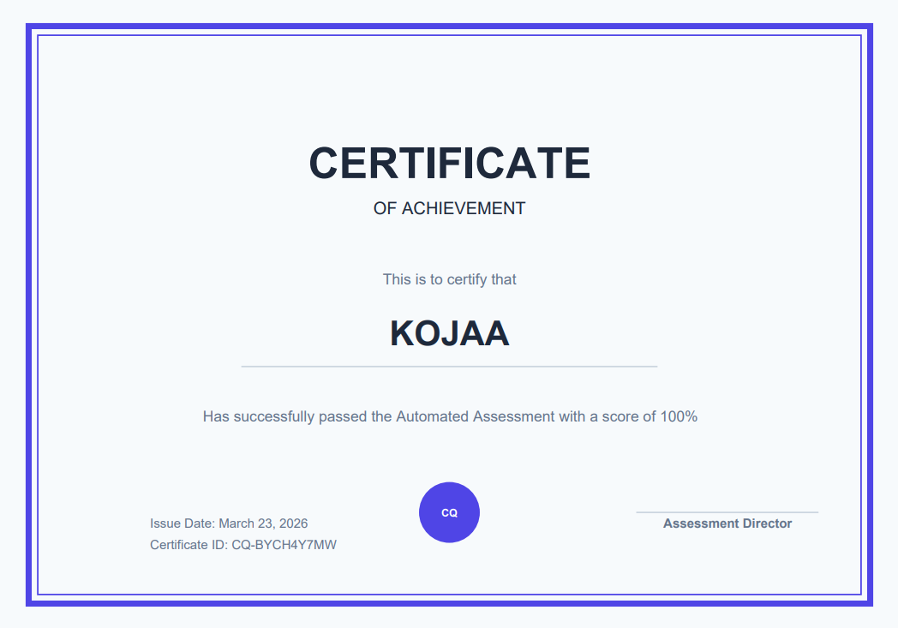
IMPLEMENTATION SCREENSHOTS
Updates UI instantly after plan selection

Slide 14
ADVANTAGES & LIMITATIONS
Advantages:
Instant
Automated
Scalable
Secure
ConsistenLimitations:
Hallucinations
Dependency
Deliverability
Connectivity
Constraints

Slide 15
Thank you

